Slide 1
Exception Handling

Slide 2
What is it?!
What is Exception Handling
Exception handling is the process of gracefully dealing with unwanted or unexpected events when a computer program runs. Exception handling is used to avoid the program or system from crashing or terminating when it encounters and error.

Slide 3
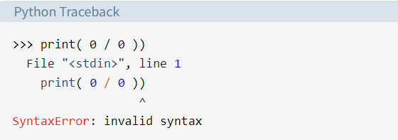
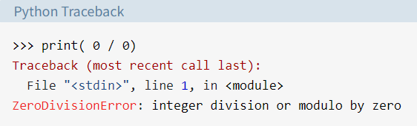
Two Kinds of Errors
Syntax Error | Logical Errors (Exceptions)
This error is caused by the wrong syntax in the code. The arrow indicates where syntax error occurred. In this example, there was one bracket too many. Remove it and run your code again. | Exceptions are raised when the program is syntactically correct, but the code resulted in an error. The last line of the message indicates what type of exception error occured.

Slide 4
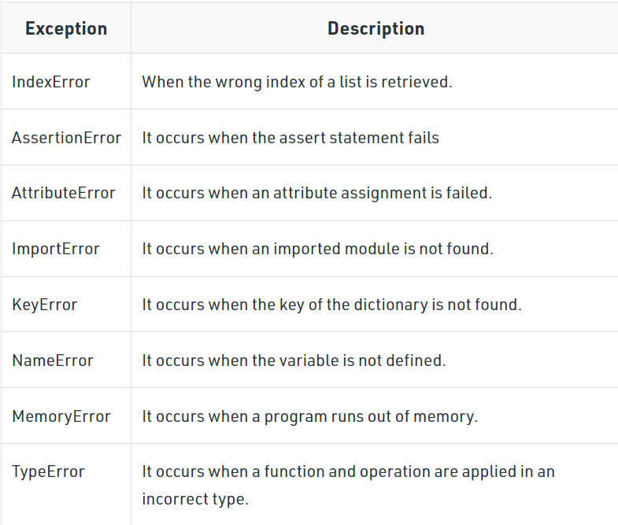
Built-in Python Errors
Some of the common built-in exceptions are:

Slide 5
Handling Errors

Slide 6
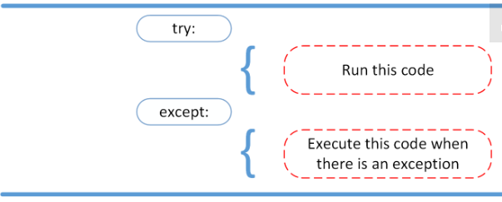
The Try and Except Block
An exception error will crash the program if it is unhandled.
Try and except statements are used to catch and handle exceptions in Python.
The try block lets you test a block of code for errors. The except block lets you handle the error.

Slide 7
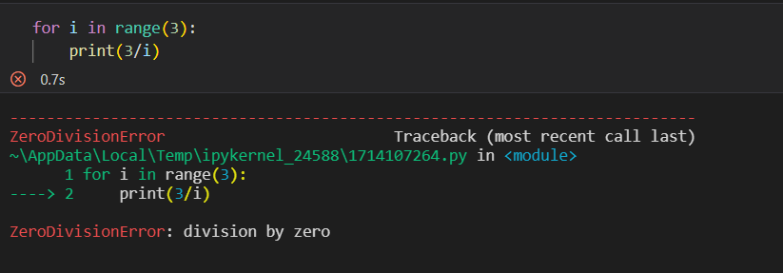
Step by Step (1)
The Error:

Slide 8
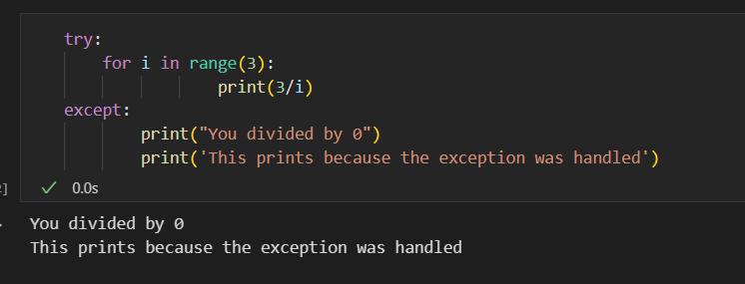
Step by Step (2)
The try/except blocks
When you think a part of your code might throw an exception, put it in a try block.

Slide 9
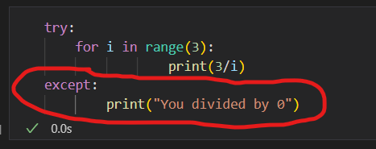
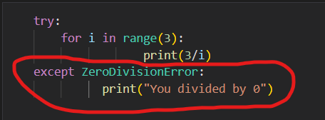
Making use of Python’s built-in errors:
The except block could be left generic. The code in the except block will be executed no matter the type of error.
Or, you can pass one of python’s built-in exceptions into except()
The except block will only be executed if the specified type of error occurred.
A generic error
Passing in a built-in python error

Slide 10
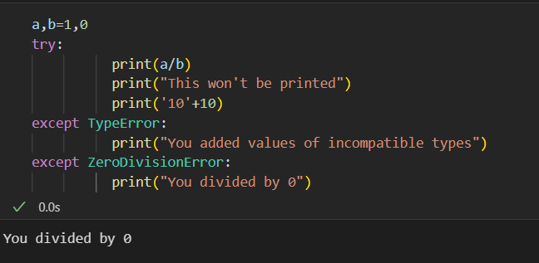
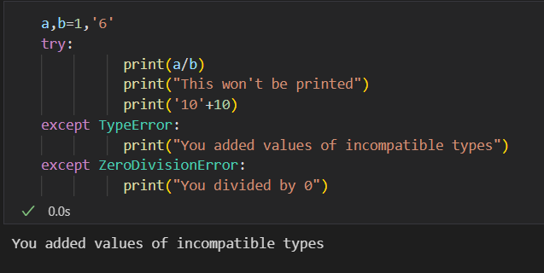
Step by Step (3)
Python Multiple Excepts
It is possible to have multiple except blocks for one try block.
When the interpreter encounters an exception, it checks the except blocks associated with that try block. When the interpreter finds a matching exception, it executes that except block.

Slide 11
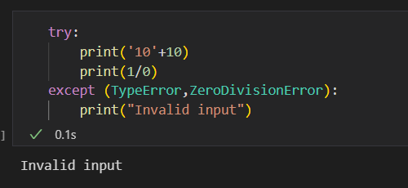
Step by Step (4)
Python Multiple Excepts in one Except
You can also have one except block handle multiple exceptions. To do this, use parentheses.

Slide 12
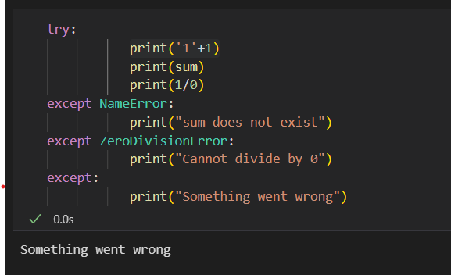
Step by Step (5)
A Generic except After All Excepts
You can add a generic except at the end.
This block will serve to handle all exceptions that go undetected by the specific except blocks
.

Slide 13
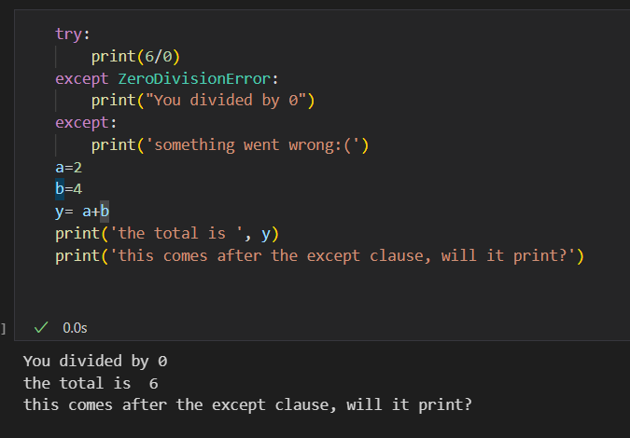
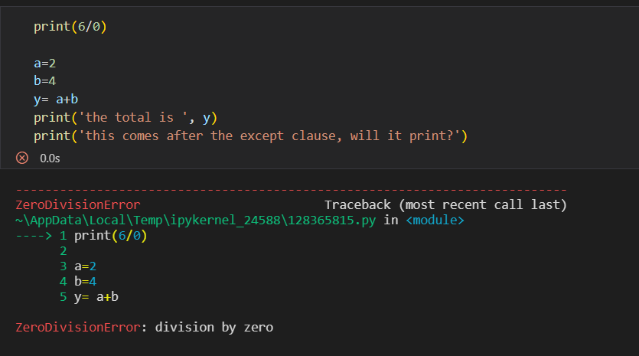
Python throws errors, Why must I handle this?
If an error occurs and the exception isn’t handled, the rest of the program won’t run. But if you handle the exception, the code after the excepts will run as expected.

